Slide 1
Four-Year Plan of Services
Greene County Department of Human Services
Greene County’s Area Agency on Aging (AAA)
2024-2028
Tami Bone, MPA Deputy Director Greene County Department of Human Services

Slide 2
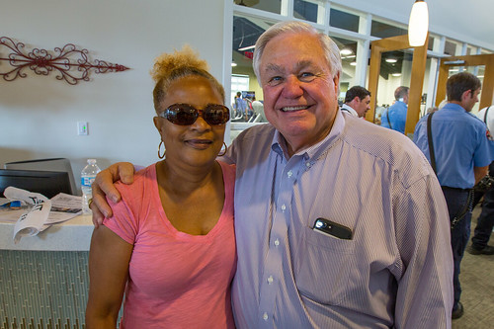
Overview of Aging Services
NUTRITION
Home Delivered Meals
Congregate Meals
Nutrition Education and Counseling
NYS Farmer’s Market Checks
Senior Center Recreation and Education
Health Promotion
TRANSPORTATION
Medical Transportation
Agency Shopping Bus
Transportation to and from Senior Centers
Vouchers for Greene County Transit buses
VOLUNTEER SERVICES
Home Delivered Meals
Medical Transportation
Helping Hands (Rotary Clubs)
Senior Angels
Rivertown Thrift Shop
INFORMATION AND ASSISTANCE
NY Connects (No Wrong Door)
Health Insurance Information Counseling and Assistance (HIICAP)
Legal Services
HEAP application and assistance
IN-HOME SERVICES AND SUPPORTS
Technological Services
Case Management
PERS
Companion Care
Personal Care Aides
Respite Care

Slide 3
GOALS

Slide 4
GOAL # 1
Further the vision of the Older Americans Act to cultivate innovative approaches reflective of local needs and preferences

Slide 5
GOAL #1: Agency Action Steps/Outcomes
Programming:
Clearly defined process
Cross-training
Consistent communication with clients, caregivers, partnering agencies
Training:
Staff training on Older Americans Act (OAA), NYS Master Plan for Aging (NYSMPA), Area Agency on Aging (AAA) organizational mission
Weekly meetings/case reviews
Monthly Staff Meeting
Technology:
Assist older adults in accessing technology (Get Set Up, Elli-Q, Trualta)
Sheriff’s Department Services: Project Lifesaver, Call-In Program
Assist older adults with internet access
Background Checks for Volunteers
Outcomes:
-OAA, NYSMPA, AAA organizational mission will inform service provision
-Older adults in need will receive services and supports in an efficient and timely manner
-Older adults’ needs will be met at all stages of service delivery

Slide 6
GOAL #2
Enable older adults to remain in their homes with high quality of life for as long as possible by providing home- and community-based services, including supports for caregivers.

Slide 7
Goal #2: Agency Action Steps/Outcomes
Services:
Established procedure for service provision
Partnerships and collaboration with other organizations
Funding:
Appropriate, effective use of funding
Utilize alternative methods of funding (ex. Unmet Needs) to eliminate wait lists
Caregivers:
Provide training, support, referrals
Establish partnerships with caregiver-focused organizations
Utilize NYSOFA caregiver assessment tools/Archangels
Outcomes:
-Person-centered, comprehensive service provision to older adults and their caregivers
-Older adults will remain in their homes for as long as possible
-Improved quality of life for older adults and caregivers

Slide 8
GOAL #3
Create an age-friendly New York where home- and community-based services are available and accessible to those who most need them, when they need them.

Slide 9
GOAL #3: Agency Action Steps/Outcomes
Increased Outreach:
Increased community engagement: everyone has a role
Attend senior club meetings, other older adult events
PSA’s, social media, print media
Flyers and notifications in public places/offices of partnering agencies
Inclusivity:
Create a welcoming, inclusive organizational atmosphere
Warmly greet visitors and callers
Inclusive, non- discriminatory signage at main office, nutrition sites
Appropriate use of language
Code of Conduct at nutrition sites
Timely Response:
Process:
NY Connects > PeerPlace queue
Senior Case Manager > Case Manager
Case Manager: assessment, facilitate services
2. Cross-training
Outcomes:
--Increased agency visibility/public awareness of available services
-Increased access to home- and community-based services and supports
-AAA will reach older adults who are most in need and provide necessary services in a timely manner

Slide 10
GOAL #4
Ensure the rights of older New Yorkers and prevent their abuse, neglect, and exploitation.

Slide 11
GOAL #4: Agency Action Steps/Outcomes
Access:
Partnership with Adult Protective Services (APS), Community Action, Sheriff’s Department and other organizations
Case Managers incorporate information into service provision
Incorporate information into community outreach
Training:
1. Regular training for staff and volunteers on recognizing the signs of abuse/neglect/exploitation and proper reporting procedure
2. Volunteer coordinator incorporate information into volunteer training
Caregiver Support:
Timely response (24 hours): initial inquiry and service provision
Partnerships with other organizations to provide vast array of services and supports
Respite
Outcomes:
-Increased awareness of elder abuse, neglect and exploitation
-Caregivers will access services and supports when they need them, well before crisis intervention becomes necessary.
-Caregivers will be better equipped to cope with the physical, psychological, social and financial demands of caring for a loved one.

Slide 12
GOAL #5
Empower older New Yorkers to stay active and healthy through Older Americans Act services and those offered under Medicare.

Slide 13
GOAL #5: Agency Action Steps/Outcomes
Awareness:
Health Insurance Information Counseling and Assistance Program (HIICAP) training
Assist older adults in accessing information on their Medicare plans
Innovation:
Partnerships with organizations that facilitate wellness services
Use of technology (wellness activities via Zoom)
Participate in county-wide wellness initiatives
Organize wellness activities and outings
Access:
Dissemination of information about wellness events
Transportation
Senior Angels to assist low-income older adults
Outcomes:
-Increased awareness of health- and wellness-related activities for older adults
-Increased participation in health- and wellness-related activities for older adults

Slide 14
GOAL #6
Integrate COVID-19 lessons and adaptations into standard practice while preparing the aging network, and those served by the network, to successfully respond and adapt to future emergencies and disasters.

Slide 15
GOAL #6: Agency Action Steps/Outcomes
Service Provision:
Before, during and after a disaster…
Case Managers contact all clients to check in, address needs
Office Manager: Mass communication
Communicate urgent client needs to Emergency Management
Shelf-stable food provided to HDM clients
Continuation of Operations Plan (COOP)
Partnerships:
Mutual service on boards/committees
Nutrition sites as venue for vaccination clinics
Presentations at senior centers
Eliminating Barriers to Vaccination:
Transportation
Financial assistance for uninsured older adults
Work with Public Health to disseminate information on the safety and efficacy of vaccines
Facilitate in-home vaccinations
Outcomes:
-Effective response on the part of the AAA to emergencies and disasters
-Timely, effective service provision to older adults in need

Slide 16
GOAL #7
Promote equitable access to older adults in greatest social and economic need throughout all programs and services administered.

Slide 17
GOAL #7: Agency Action Steps/Outcomes
Shared Objective:
Organizations that serve target population
Dissemination of information
Increased outreach
Aging Advisory Board members
Training:
Training with partner organizations
Weekly check-in meetings, case reviews
Cross-training
Monthly meetings
Collaboration:
Utilize existing partnerships and develop new partnerships
Maintain updated Directory of Services
Outcomes:
-The quality of life of older adults in greatest social and economic need will be improved.
-The needs of older adults in greatest social and economic need will be addressed in a timely and effective manner, decreasing the need for crisis intervention.

Slide 18
GOAL #8
Support continuation and growth of state and local policy, programs, and investments that compliment and expand upon Older Americans Act programs.

Slide 19
GOAL #8: Agency Action Steps/Outcomes
Awareness of Policy:
Executive Director/designee attend Department Head meetings, Legislative meetings
Administration and staff participate in networking: Long-Term Care Council (LTCC), Aging Concerns Unite Us (ACUU) annual confernce
Membership in US Aging (federal)
Partnerships:
With state and local elected officials
County Legislator on Aging Advisory Board
Share updates on aging-related policy, funding with Legislators
Invite elected officials to AAA events
Innovation:
Maintain partnerships and develop new partnerships to ‘stretch’ funding (ex. Rotary, Elks Club)
Enhance efforts to recruit volunteers
Outcomes:
-Effective partnership between the AAA and elected officials and advocacy will lead to positive changes in policy to the benefit of older adults

Slide 20
GOAL #9
Family caregivers will be recognized, assisted, included, supported, and engaged through a variety of programs so that they can care for their care receiver at home for as long as possible.

Slide 21
GOAL #9: Agency Action Steps/Outcomes
Information:
Utilize a variety of methods to disseminate information
Extensive, appropriate training for NY Connects and Case Management staff
Archangels Caregiver assessment
Partnerships:
Caregiver-focused organizations
Establish policy informed by NYSOFA and best practice through partnerships
Services and Supports:
Wellness events for caregivers
Respite care
Support group for caregivers
Outcomes:
-Decrease in caregiver burnout, stress-related illness
-Caregivers will be acknowledged and nurtured
-Care receivers will remain at home for as long as possible

Slide 22
DEMOGRAPHICS/TARGETING OBJECTIVES
 | ACS* Five-Year Estimates | Registered Clients | Minimum # Clients to be Served Annually | #Registered Clients to be Served Annually
1. Age 60 and up | 16,625 | 724
2. # to be Served |  |  |  | 750
3. Breakdown:
a. 75-54 | 5,970 | 275 |  | 250
b. 85+ | 1660 | 259 |  | 250
c. Live Alone | 3,875 | 401 | 175 | 250
*: American Community Survey

Slide 23
DEMOGRAPHICS/TARGETING OBJECTIVES (cont.)
Clients by Ethnicity/Race
 | ACS Five-Year Estimates | Total # Registered Clients | Minimum # Clients to be Served Annually | # Registered Clients to be Served Annually
d. Hispanic | 315 | 5 | 15 | 20
e. Native American/Alaskan | 69 | 0 | 3 | 3
f. Asian | 115 | 0 | 6 | 6
g. Black/African-American | 295 | 7 | 14 | 25
h. White | 14,110 | 651 |  | 700
i. Native American/Pacific Islander | 4 | 0 | 1 | 1
j. MENA**
k. Other | 69 | 0 | 4 | 4
l. Two or More Races | 59 | 3 | 3 | 3
**: Middle Eastern/Northern African

Slide 24
DEMOGRAPHICS/TARGETING OBJECTIVES (cont.)
Clients by Key Characteristics
 | ACS Five-Year Estimates | Total # Registered Clients | Minimum # Clients to be Served Annually | # Registered Clients to be Served Annually
m. Frail and/or Disabled | 3,240 | 264 | 147 | 150
n. Low-Income (Below 150%) | 2,680 | 179 | 121 | 125
o. Low-Income Minority (Below 150%) | 275 | 5 | 13 | 15
p. Limited English Proficiency | 235 | 5 | 11 | 15
q. Rural | 11,279 | 268 | 509 | 550

Slide 25
DEMOGRAPHICS/TARGETING OBJECTIVES (cont.)
Outreach: LGBTQ | -Pride events -Office and nutrition sites will be inclusive and welcoming -Recruit members of the LGBTQ community to serve on Aging Advisory Board
Health Inequities | -No hospital in Greene County; enhance access to care -Prevalence of respiratory illness -Partnerships with Public Health, healthcare providers and other health-focused organizations re: smoking cessation, COVID, vaccinations, cancer screenings, preventive care, wellness -Services provided by Valatie Rescue Squad
Hispanic Population | -Establish relationships with community leaders -Maintain welcoming environment -Bilingual written material, signage -Presence in senior housing
Languages/Limited English Proficiency | -Language Line -Interpreters -Mid-Hudson Library System: American Sign Language (ASL)

Slide 26
DEMOGRAPHICS/TARGETING OBJECTIVES (cont.)
Americans with Disabilities Act (ADA) | -Partnerships with Northeastern Association for the Blind (NABA), Independent Living Center (ILC) and other organizations -Shopping bus equipped with wheelchair lift -Contracted Medical Transportation services with wheelchair lift -All nutrition sites are handicapped accessible -Large-Print materials available
Modification of Services of Target Populations | -Contract with Mom’s Meals for special dietary needs -Multicultural events -Multigenerational activities -CAPTEL for hearing impaired
Self-Monitoring | -Use qualitative and quantitative data to monitor -Weekly meetings -Supervisor reviews, reports

Slide 27
NEEDS ASSESSMENT & PLANNING PROCESS
DATA COLLECTION AND ANALYSIS
-Random Sample Survey
-POLCO Community Assessment Survey for Older Adults (CASOA)
-New York State Office of Aging (NYSOFA) Service Needs Assessment Tool provided in 14-TAM-02
-Community Forums
-Public Hearings
-Meetings with Older Adults
-Census/Demographic Data
-CAARS Reporting Data
-NY Connects Data
-AAA and contractor information, such as program surveys, information and assistance records, unmet need and case files
-AAA reports to Greene County Legislature or boards of directors
-Long-Term Care Council Member Interviews/Reports

Slide 28
NEEDS ASSESSMENT & PLANNING PROCESS
Greene County’s Needs
NEED: | IMPACT:
1. Affordable Housing | -Seniors unable to maintain homes, pay for upkeep, utilities, risk of falls and other safety concerns; isolation/vulnerability -Seniors pay high percentage of income for substandard housing, unable to afford food, medication and other necessities -Working individuals, families unable to afford housing/forced to relocate (depletes workforce, impacts elder care)
2. Personal Care Aides | -Seniors are placed on wait lists for services -Injury, illness leads to long-term care placement
3. Transportation | -Seniors unable to access healthcare, groceries, pharmacies, senior centers -Negative health outcomes, social isolation/vulnerability

Slide 29
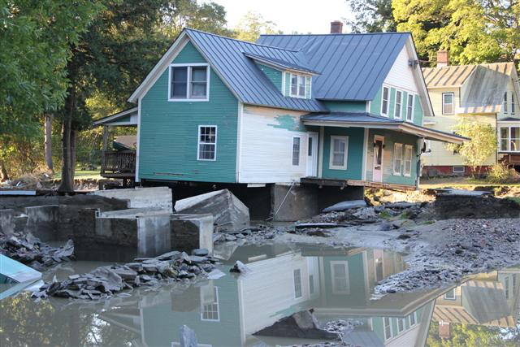
Emergency Preparedness and Response
AAA participates in:
Local Emergency Operations drills/tabletop exercises
Distribution of emergency preparedness checklist
Mass communication prior to, during and after and emergency event
Personal emergency planning included in Case Management discussion
Providing list of vulnerable adults for wellness checks
Developing policies and procedures for staff and supervisors to perform emergency response activities
Continuation of Operations Plan (COOP)

Slide 30

Emergency Preparedness and Response (cont.)
COMMUNICATION:
-REGROUP
-Social Media
-Phone calls
Our Partners:
-Greene County EOC
-Red Cross
-First Responders
-Greene County Public Health Department
-Alzheimer’s Association
-Greene County Sheriff’s Department
Keeping our Seniors Safe:
-Sheriff’s Department Senior Call-In Program and Project Lifesaver
-Shelf-Stable Emergency Meals
-First 48 Hours
-Yellow Dot Program

Slide 31
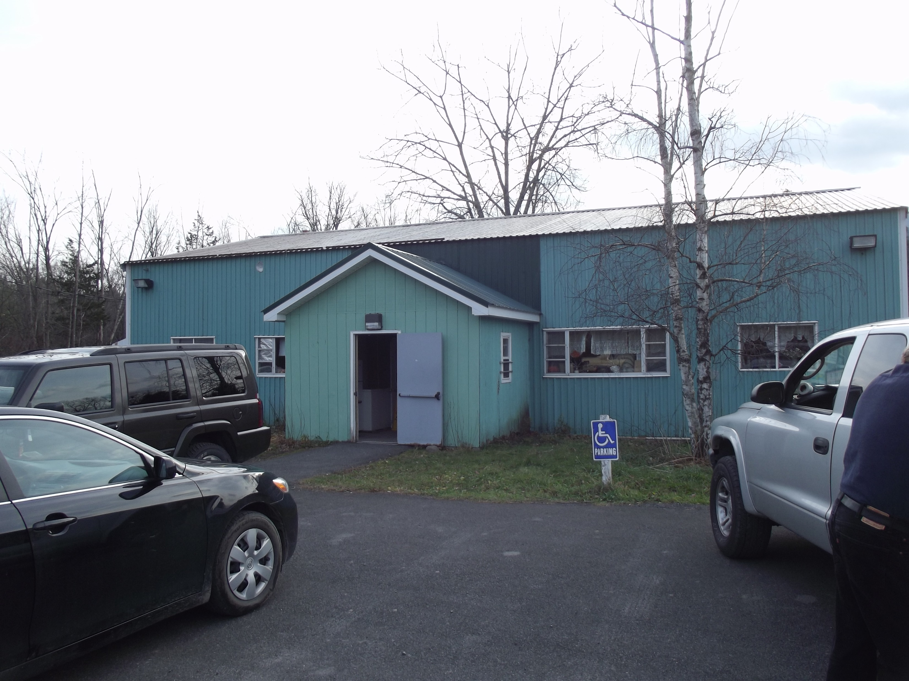
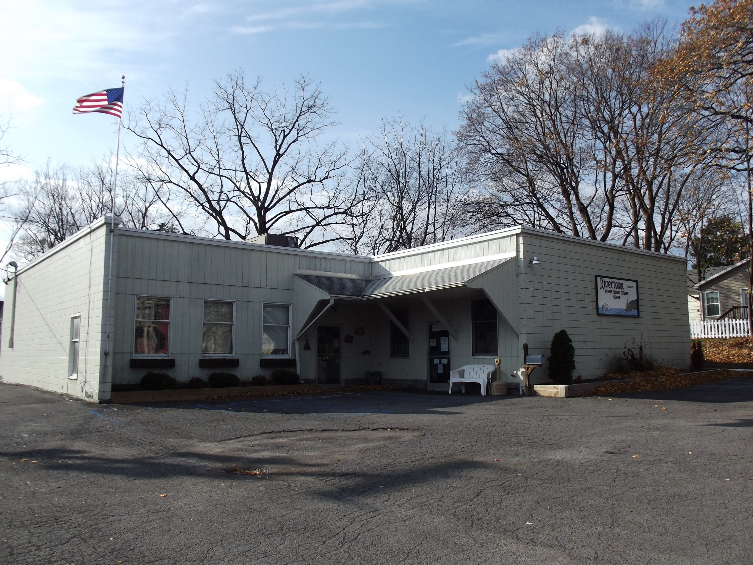
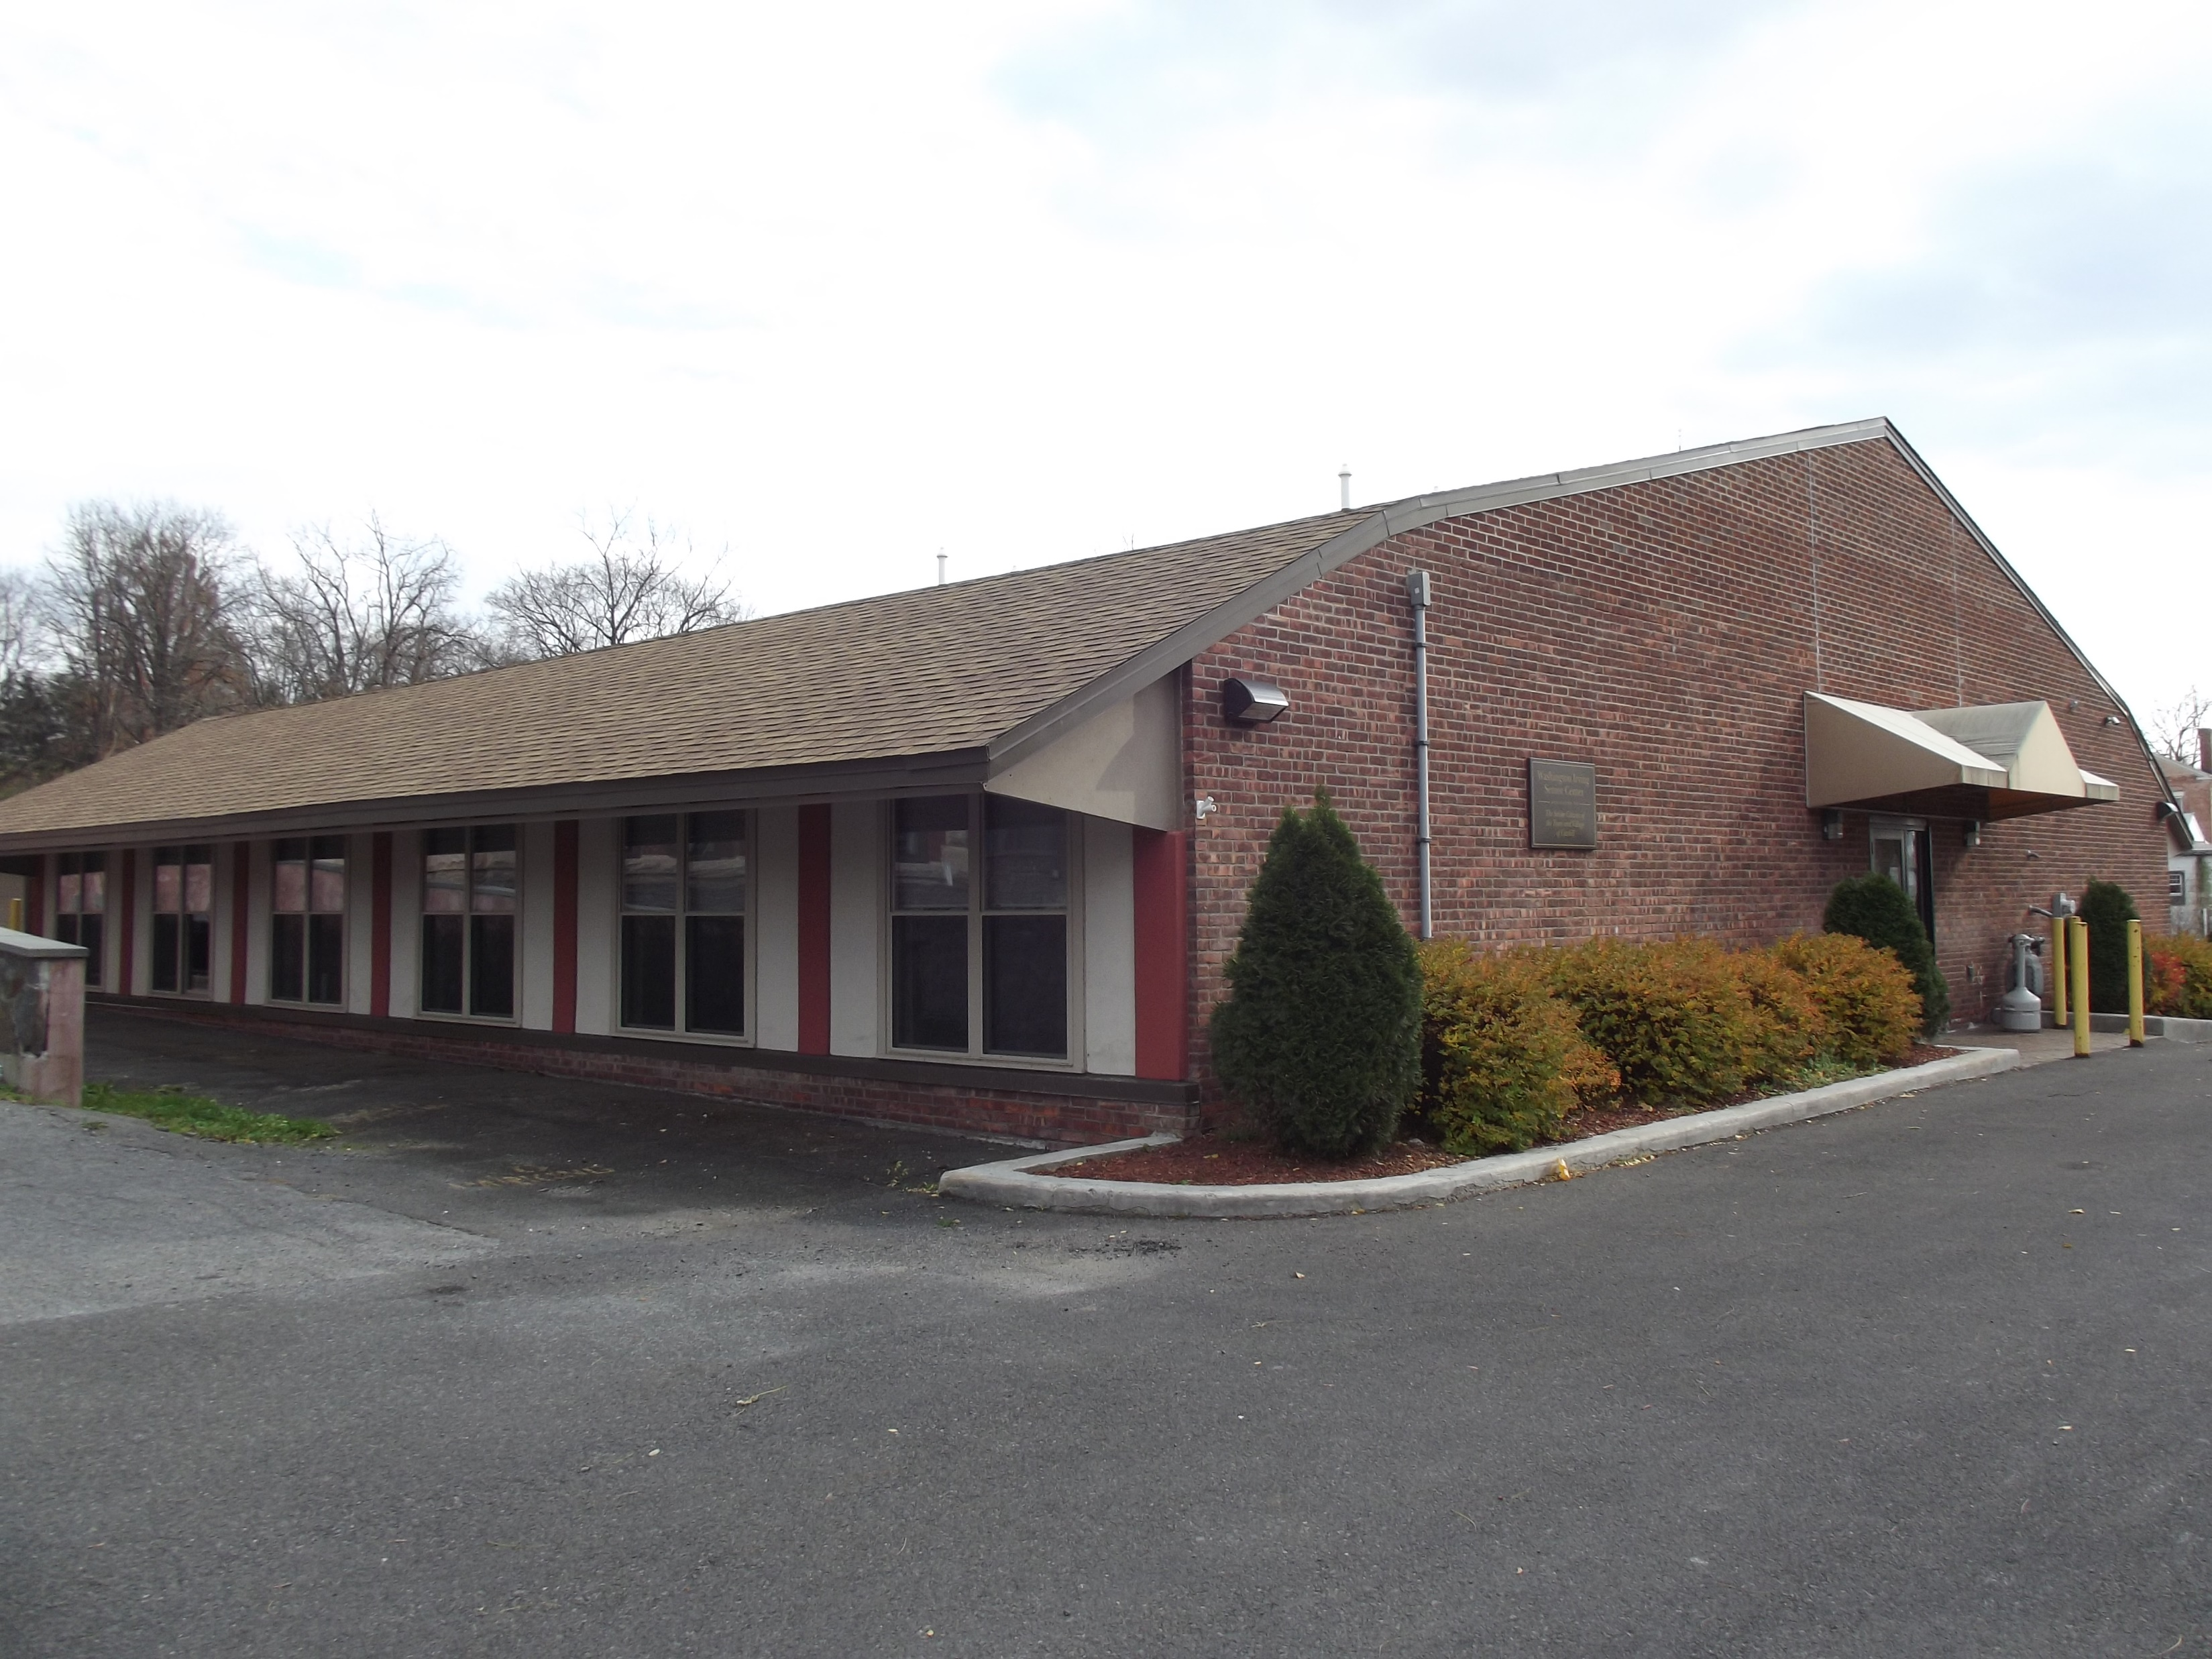
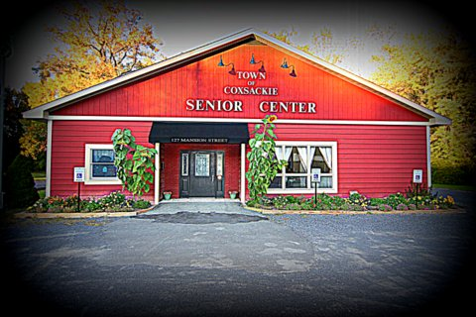
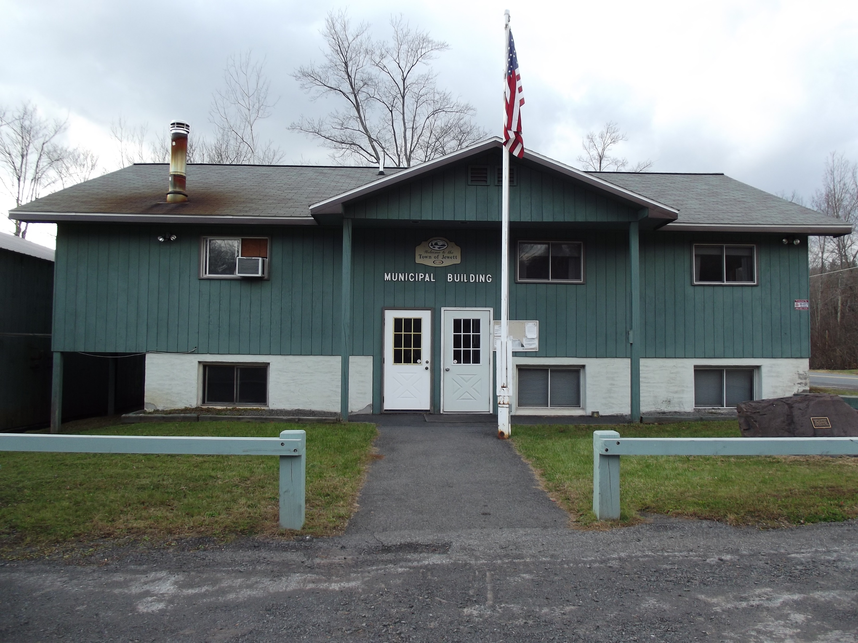
Nutrition Sites
Acra Senior Center
Rivertown Senior Center (Athens)
Robert C. Antonelli Center (Catskill)
Coxsackie Senior Center
Jewett Senior Center

Slide 32

Health Promotion
Title IIID of the Older Americans Act of 1965
Evidence-Based Health Promotion Programs:
A Matter of Balance
Bingosize
Chair Yoga
Tai Chi: Moving for Better Balance
This Photo by Unknown Author is licensed under CC BY-NC-ND

Slide 33
Caregiver Services
Title IIIE of the Older Americans Act of 1965
“AAAs that accept National Family Caregiver Support Program (NFCSP) funds from NYSOFA must establish and operate a caregiver support program that:
Meets the needs of the caregiver and enhances support given to the care receiver
Helps the caregiver become a better advocate and more confident in assisting the care receiver with their needs
Deters placement in a long term care facility and promotes continuing care within the home and/or in alternative community settings for older adults for as long as possible…”
When caregivers are well supported, those that they care for can stay at home longer and have a better quality of life.

Slide 34

Caregiver Services (cont.)
In-Home Companion Care
Social Adult Daycare
Personal Emergency Response System (PERS)
Home Deliver Meals
Respite
Referral Services
Information and Assistance
Medical Transportation
Technological Tools:
-Elli-Q
-Animatronic Pets
-Trualta
-Get Set Up
Greene County Sheriff’s Department Call-In Program and Project Lifesaver
Alzheimer’s Association Support Groups

Slide 35

Case Management
Clients’ comprehensive needs are assessed in a person-centered and culturally and linguistically appropriate manner.
Comprehensive Assessment for Aging Network Community-Based Long-Term Care Services (COMPASS) is completed annually.
Based on the findings of the COMPASS, appropriate referrals are made to address health or medical needs: falls assessment, TBI supports, etc.
Care Plan reflects the individual’s strengths, self-identified needs and informal supports.
Bi-monthly check-in calls and visits
Application assistance

Slide 36
Case Management: Four-Year Plan
Year | Plan
One | -Training on Person-Centered Planning, Trauma-Informed Care, TBI, Dementia-Related Illness -Collaboration with other organizations on training (Public Health, Alzheimer’s Association, SAGE, NABA) -Prioritize training needs to best address the needs of Greene County’s older adult population, particularly those in most social and economic need, underserved population
Two | -Implement ‘Train the Trainer’ program -Enhance diversity and inclusion training -Annual refresher courses for staff
Three | -Utilize demographic and other information to update and expand training -Analyze the manner in which training impacts service delivery -Annual refresher courses for staff
Four | -Agency-wide analysis of training and its impact on service delivery -Takeaways from analysis used to inform next Four-Year Plan

Slide 37
Questions? Comments? Suggestions?

